Slide 1
Data visualization:
basic principles

Slide 2
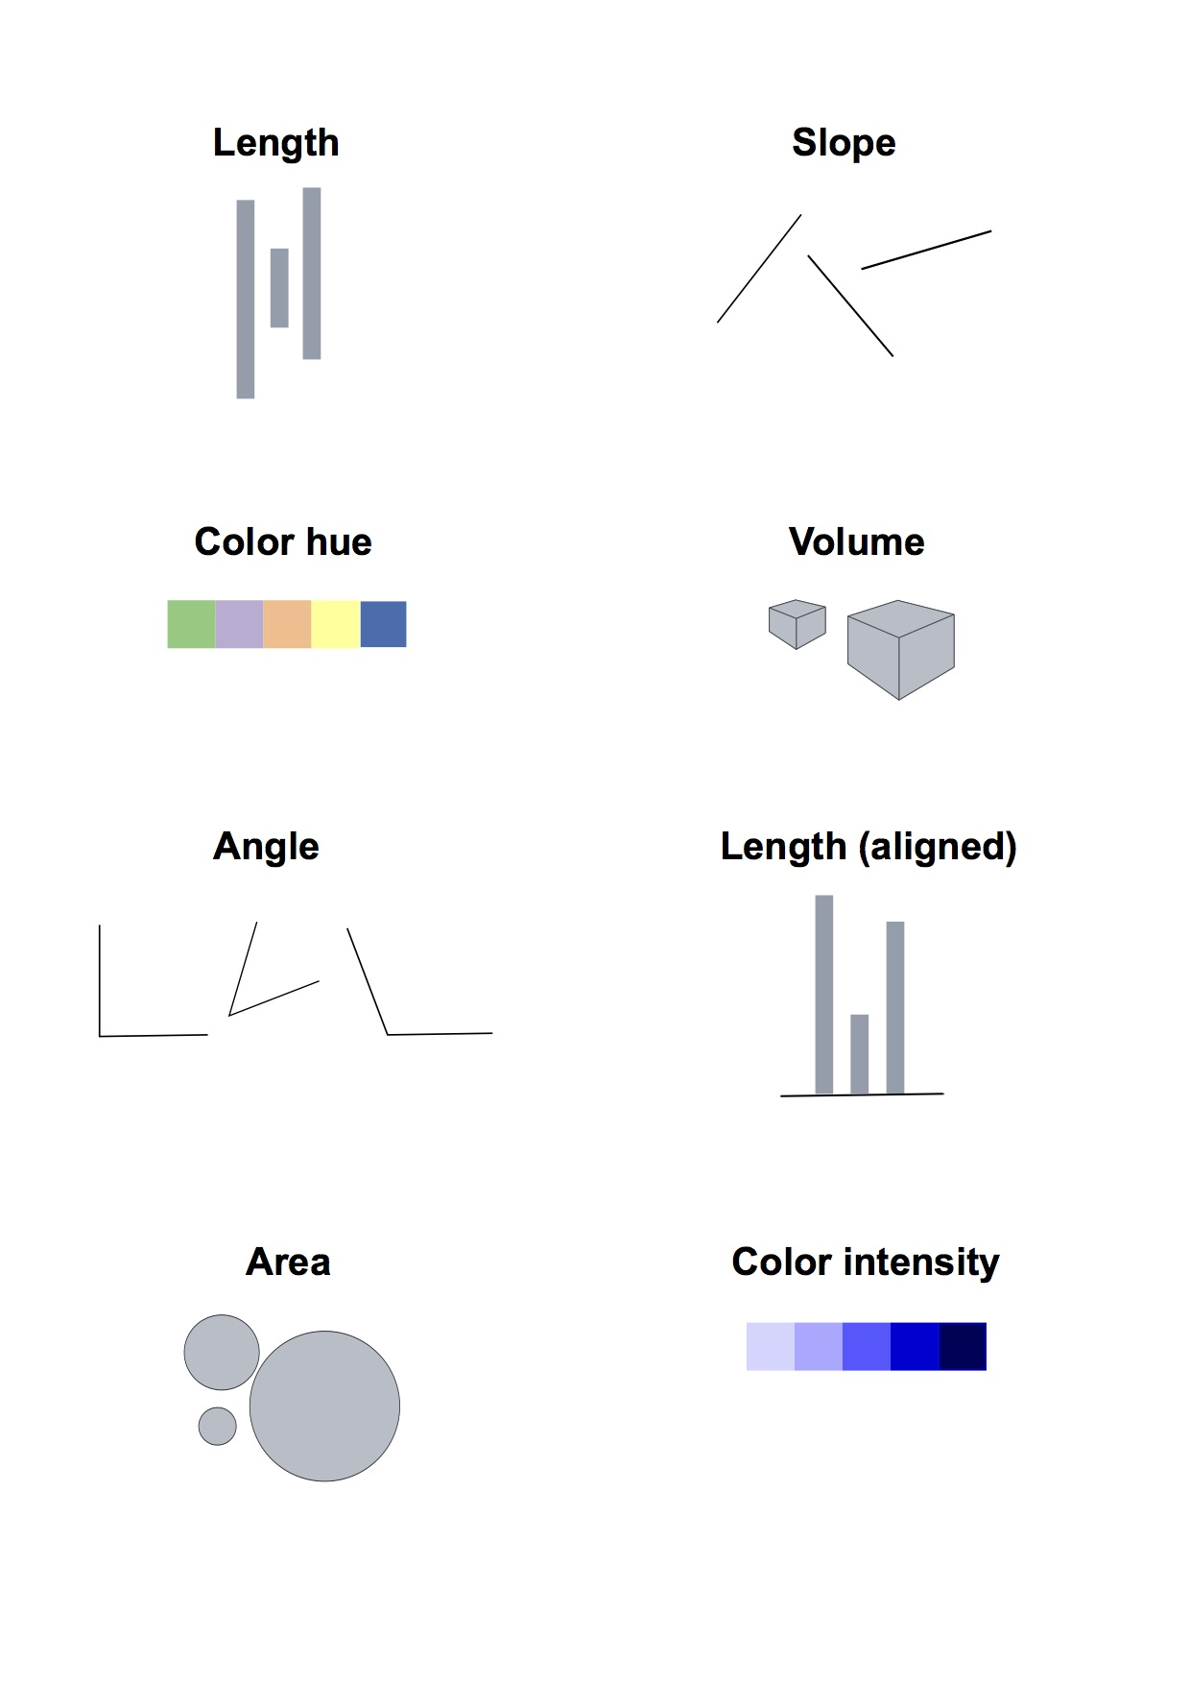
Visualization: encoding data by visual cues
Notes:
Whenever we visualize, we are encoding data using visual cues, or “mapping” data onto variation in size, shape or color, and so on. There are various ways of doing this, as this primer illustrates:

Slide 3
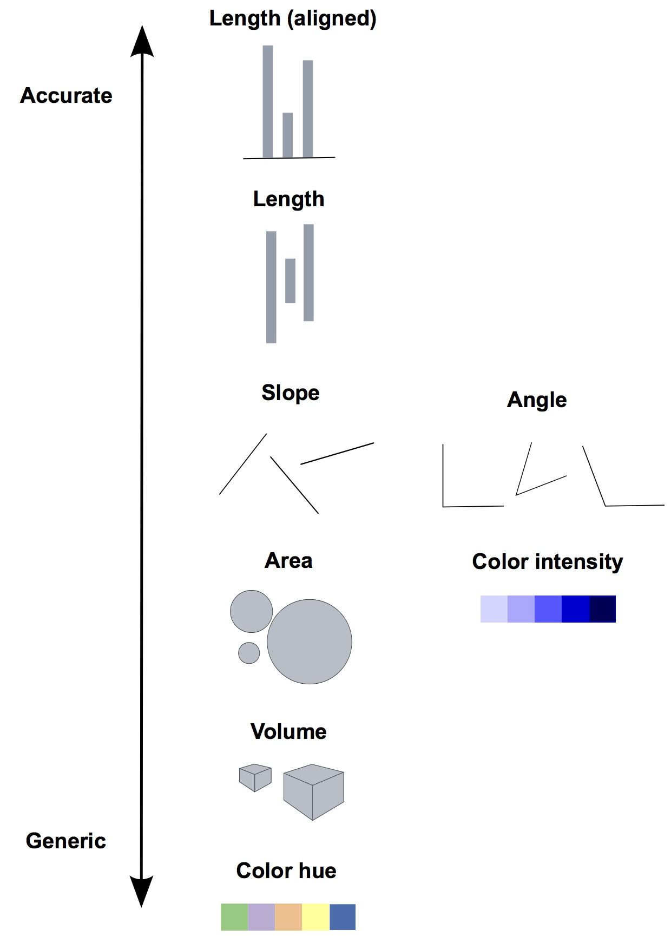
Our brains do not treat those cues equally!
Notes:
These cues are not created equal, however. In the mid-1980s, statisticians William Cleveland and Robert McGill ran some experiments with human volunteers, measuring how accurately they were able to perceive the quantitative information encoded by different cues. This is what they found:
This perceptual hierarchy of visual cues is very important. When making comparisons with continuous variables, aim to use cues near the top of the scale wherever possible.
That doesn’t mean the other possibilities are always to be avoided in visualization. Indeed, as we’ve already noted, color hue can a good way of encoding categorical data. The human brain is particularly good at recognizing patterns and differences. This means that variations in color, shape and orientation, while poor for accurately encoding the precise value of continuous variables, can be good choices for representing categorical data.
You can also combine different visual cues into the same graphic to encode different variables. But always think about the main messages you are trying to impart, and where you can use visual cues near the top of the visual hierarchy to communicate that message most effectively.
3

Slide 4
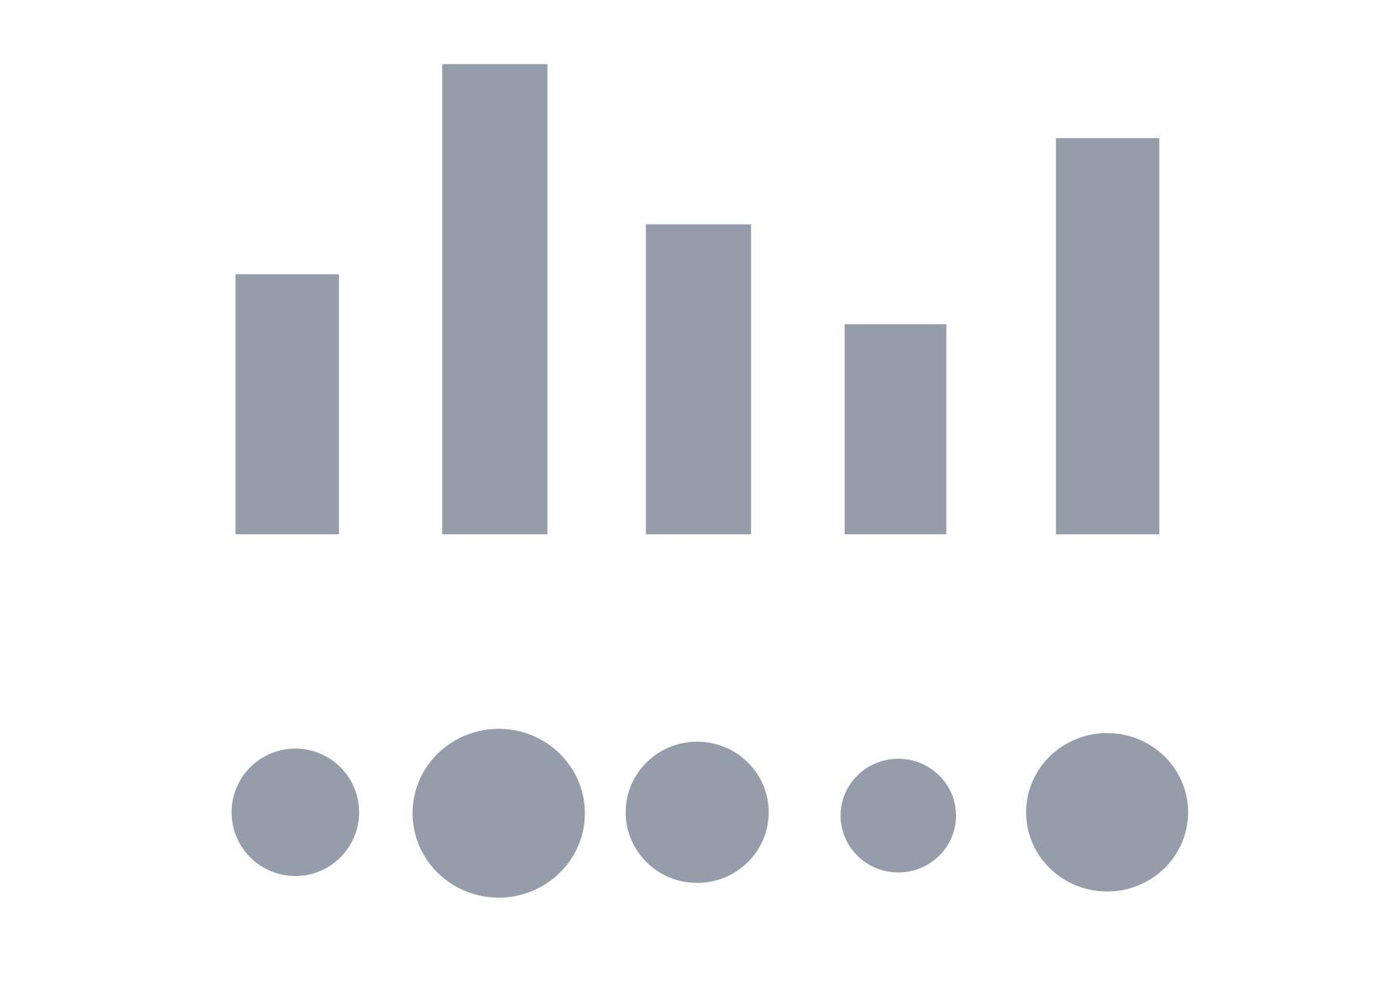
Design for the human brain!
Notes:
To witness this perceptual hierarchy, look at these visual encodings of the same simple dataset. Do the bars, or the circles, make it easiest to “read” the numerical values that are encoded?
4

Slide 5
What type of chart should I use?
Notes:
This is a frequently asked question, and the best answer is: Experiment with different charts, to see which works best to liberate the story in your data. Some visualization software — notably Tableau Public — will suggest chart types for you to try. However, it is good to have a basic framework to help you prioritize particular chart types for particular visualization tasks.

Slide 6
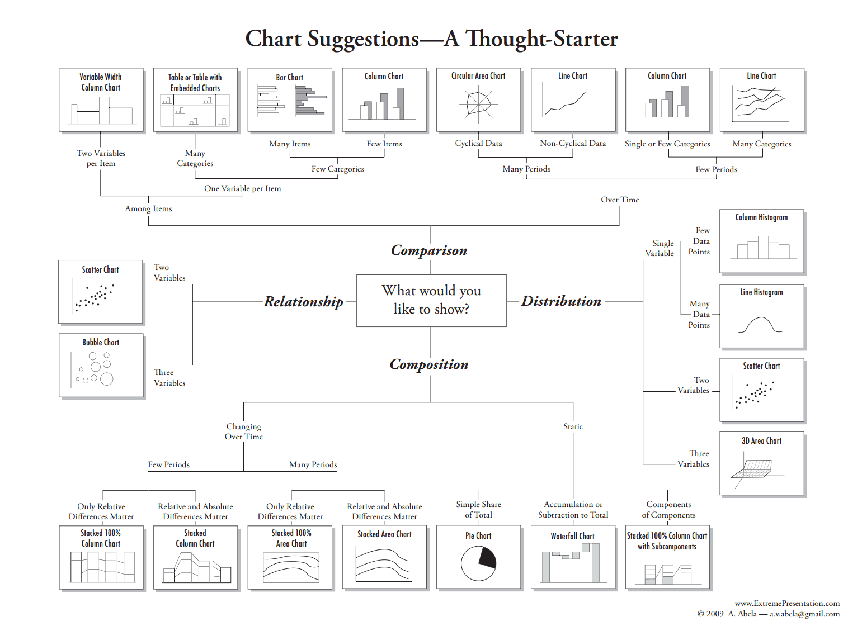
Notes:
Although it is far from comprehensive, and makes some specific chart suggestions that I would not personally endorse, the “chart of charts” published on the Extreme Presentation Method website provides a useful framework by providing answers to the question: “What would you like to show?”
It considers four possible answers: the distribution of a single continuous variable; the relationship between two continuous variables; comparisons between items for a single continuous variable; and composition, or how parts make up the whole.
We’ve already discussed distibutions, so let’s now consider the others one by one:
6

Slide 7
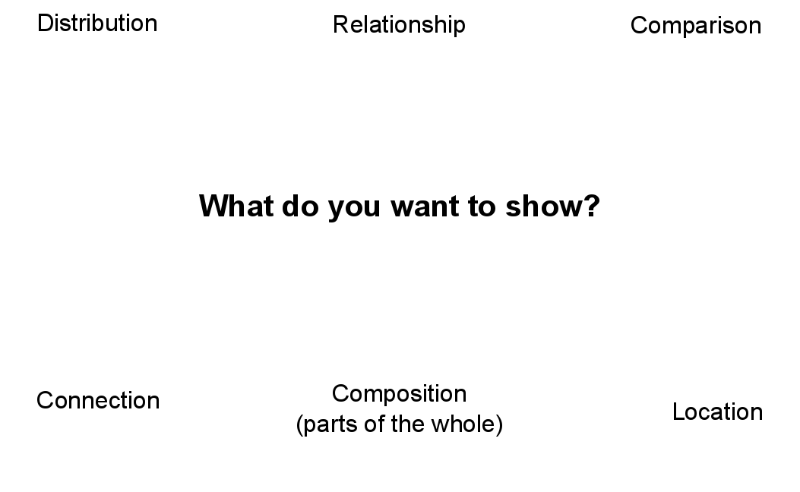
Notes:
This is a frequently asked question, and the best answer is: Experiment with different charts, to see which works best to liberate the story in your data.

Slide 8
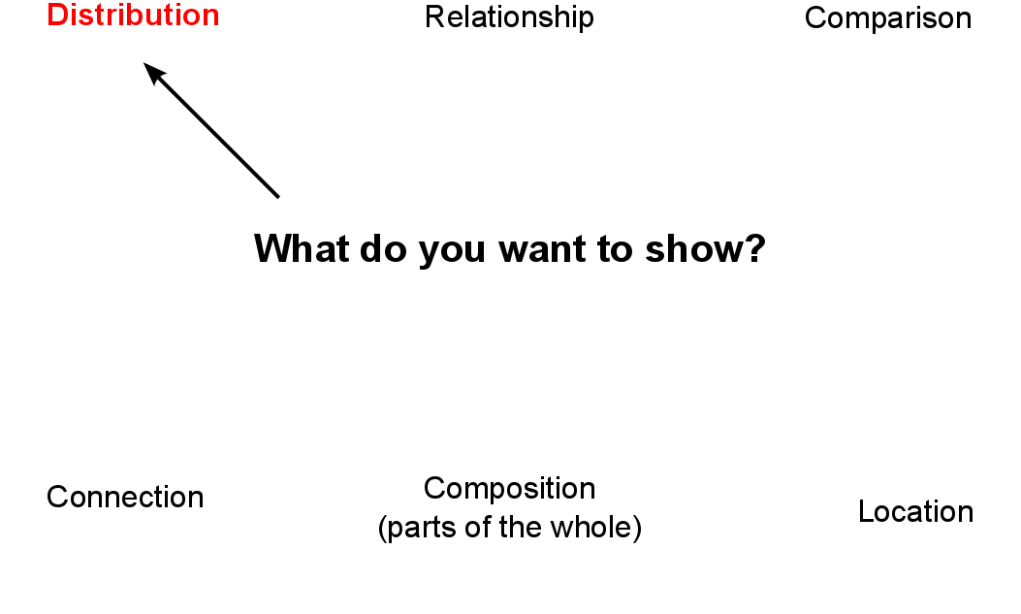
Notes:
This is a frequently asked question, and the best answer is: Experiment with different charts, to see which works best to liberate the story in your data.

Slide 9
Notes:
So, we have already considered charts to show the distribution of a single continuous variable …
9

Slide 10
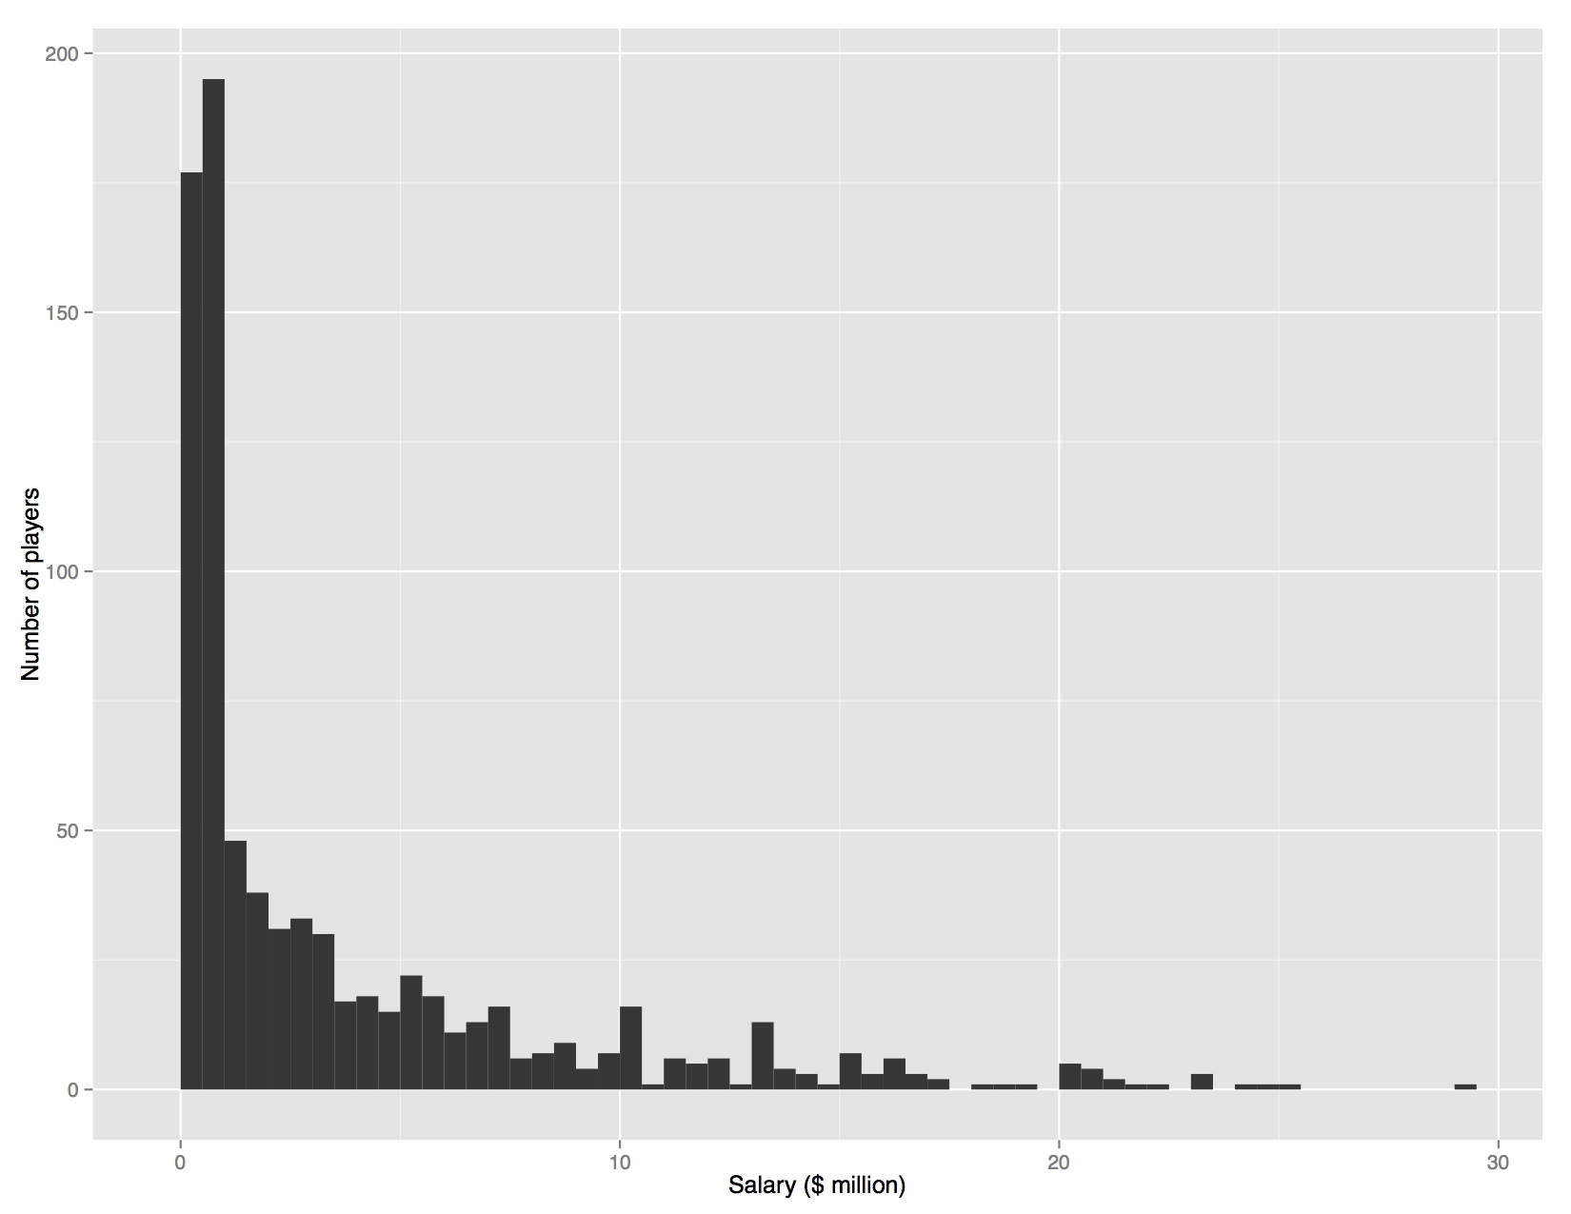
Consider the distribution
Notes:
Sometimes, however, it’s very clear just from looking at the shape of a dataset that it is not normally distributed. Here, for example, is the distribution of 2013 Major League Baseball salaries, drawn as columns in increments of $500,000. This type of chart is called a histogram:
This distribution is highly “skewed.” Almost half of the players are in the lowest two columns, paid less than $1 million. There are just a handful of players who were paid more than $20 million; Alex Rodriguez, paid $29 million by the New York Yankees, lies to the right of the chart on his own. Knowing this distribution may influence the story you would choose to tell from the data, the summary statistics you would choose to aggregate it, and the methods you might use to visualize it.

Slide 11
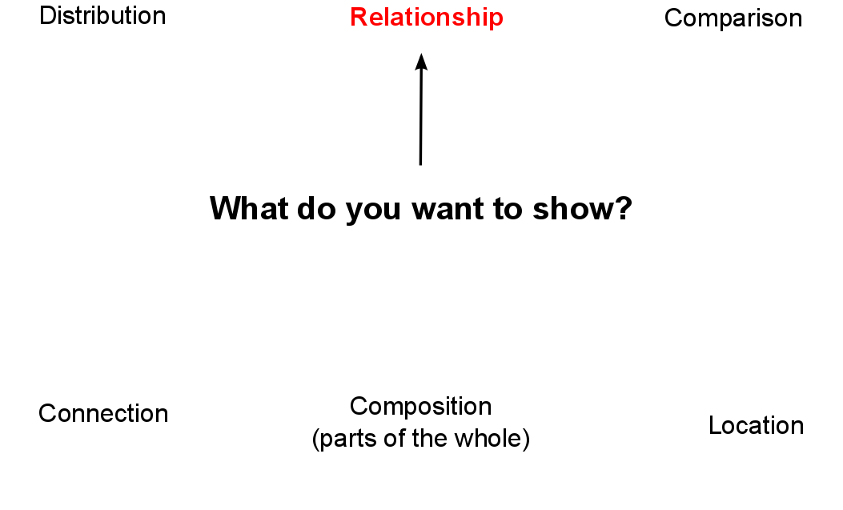
Notes:
This is a frequently asked question, and the best answer is: Experiment with different charts, to see which works best to liberate the story in your data.

Slide 12
Notes:
12

Slide 13
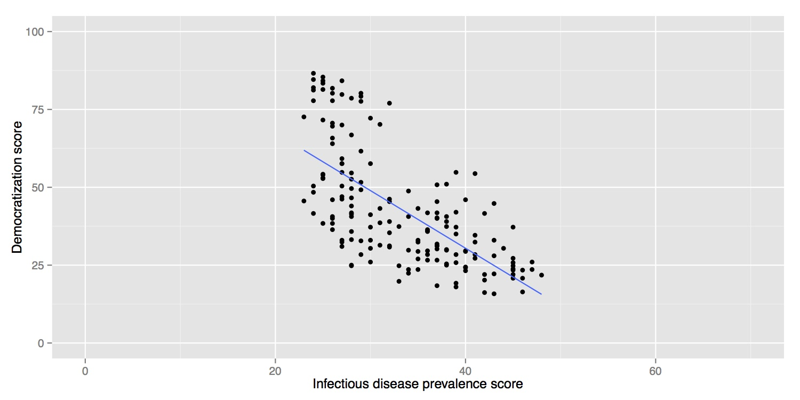
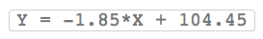
Relationships between variables: scatter plots and trend lines
Notes:
When testing the relationship between two variables, statisticians will usually draw a simple chart called a scatter plot, in which the records in a dataset are plotted as points according to their scores for each of the two variables. (This uses the visual cue of position on an aligned scale, which sits near to the top of the perceptual hierarchy.)
Here is an example scatter plot, illustrating a controversial theory claiming that the extent to which a country has developed a democratic political system is driven largely by the historical prevalence of infectious disease:
The convention when drawing scatter plots is to put the variable suspected to be the causal factor, called the “explanatory” variable, on the horizontal or X axis, and the “response” variable on the vertical or Y axis.
When producing any chart based on the scatter plot format, it’s a good idea to follow this convention, because otherwise you are likely to confuse people who are used to viewing such graphs.
The example above also shows a straight line drawn through the points. This is known as a “trend line,” or the “line of best fit” for the data, and was calculated by a method called “linear regression.” It is a simple example of what statisticians call “fitting a model” to data.
Models are mathematical equations that allow statisticians to make predictions. The equation for this trend line is:
Y = -1.85*X + 104.45
Here X is the infectious disease prevalence score, Y is the democratization score, and 104.45 is the value at which the trend line would cross the vertical axis at X = 0. The slope of the line is -1.85, which means that when X increases by a single point, Y tends to decrease by 1.85 points. (For a trend line sloping upwards from left to right, the slope would be a positive number.)
The data used for this graph doesn’t include all of the world’s countries. But if you knew the infectious disease prevalence score for a missing nation, you could use the equation or the graph to predict its likely democratization score. To see how this works multiply 30 by -1.85, then add 104.45. The answer is roughly 49, and you will get the same result if you draw a vertical line up from the horizontal axis for an infectious disease prevalence score of 30, and then draw a horizontal line from where this crosses the trend line to the vertical axis at X = 0.

Slide 14
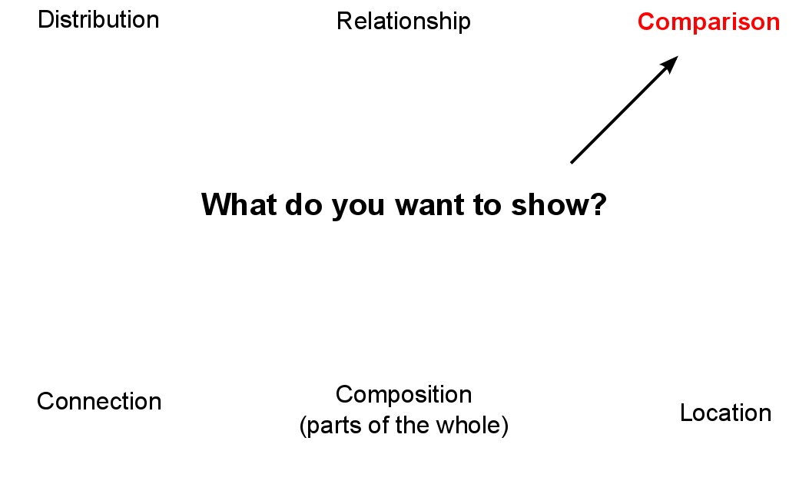
Notes:
This is a frequently asked question, and the best answer is: Experiment with different charts, to see which works best to liberate the story in your data.

Slide 15
Notes:
So let’s now explore possibilities for comparison between items for a single continuous variable, and composition, or how parts make up the whole. In each case, this framework considers both a snapshot at one point in time, and how to visualize comparison and composition over time — a common task in data journalism.
Applying the perceptual hierarchy of visual cues, bar and column charts are usually the best options for simple comparisons.
15

Slide 16
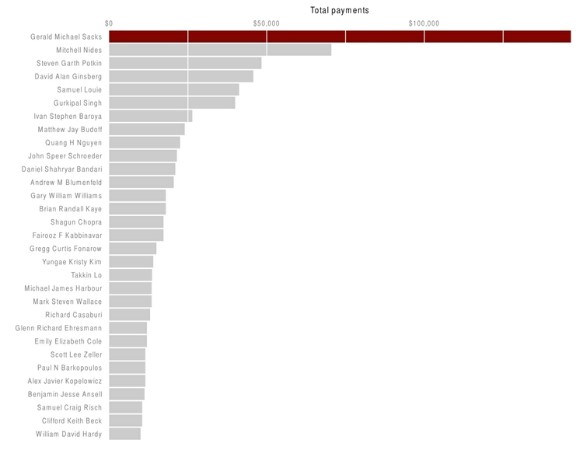
Simple comparisons: bars and columns
Notes:
Applying the perceptual hierarchy of visual cues, bar and column charts are usually the best options for simple comparisons. Vertical columns often work well when few items are being compared, while horizontal bars may be a better option when there are many items to compare.
16

Slide 17
Notes:
Comparisons: change over time
17

Slide 18
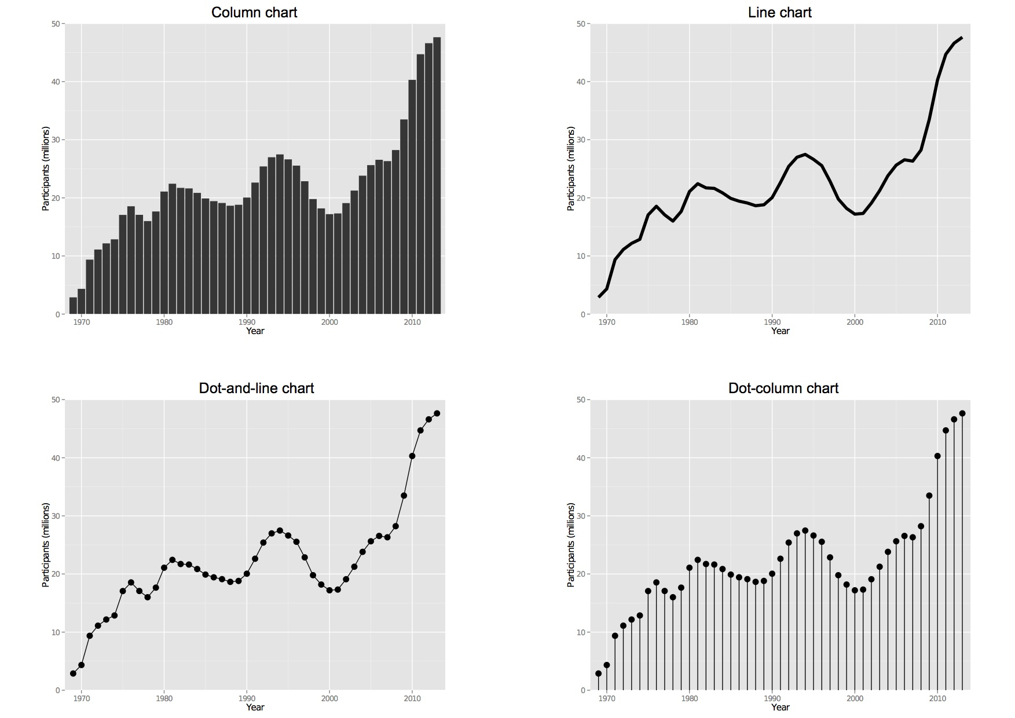
Comparisons: change over time
Notes:
Bar or column charts can also be used to illustrate change over time, but there are other possibilities, as shown in these charts showing participation in the federal government’s food stamps nutritional assistance program, from 1969 to 2014.
Each of these charts communicates the same basic information with a subtly different emphasis. The column chart emphasizes each year as a discrete point in time, while the line chart focuses on the overall trend or trajectory. The dot-and-line chart is a compromise between these two approaches, showing the trend while also drawing attention to the value for each year. (The dot-column or lollipop chart is an unusual variant of a column chart, included here to show another possible design approach.)

Slide 19
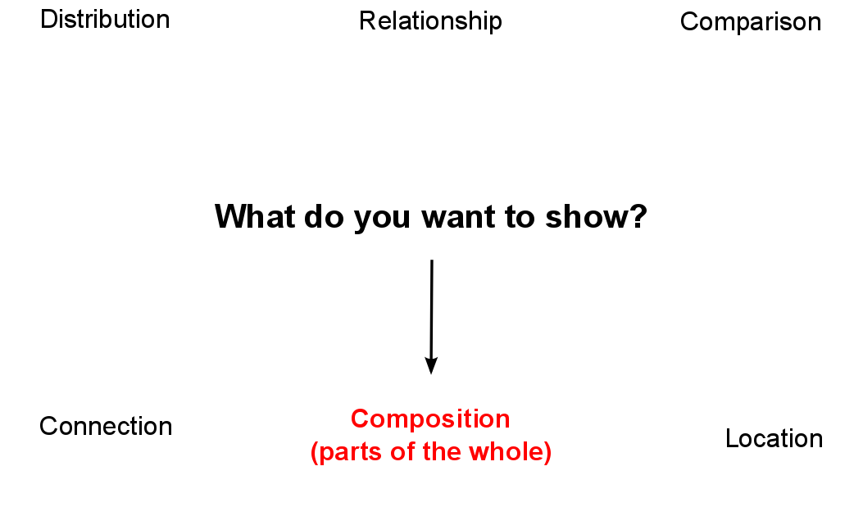

Slide 20
Notes:
Composition: parts of the whole
This is where the much-maligned pie chart does have a role, although it is not the only option.
20

Slide 21
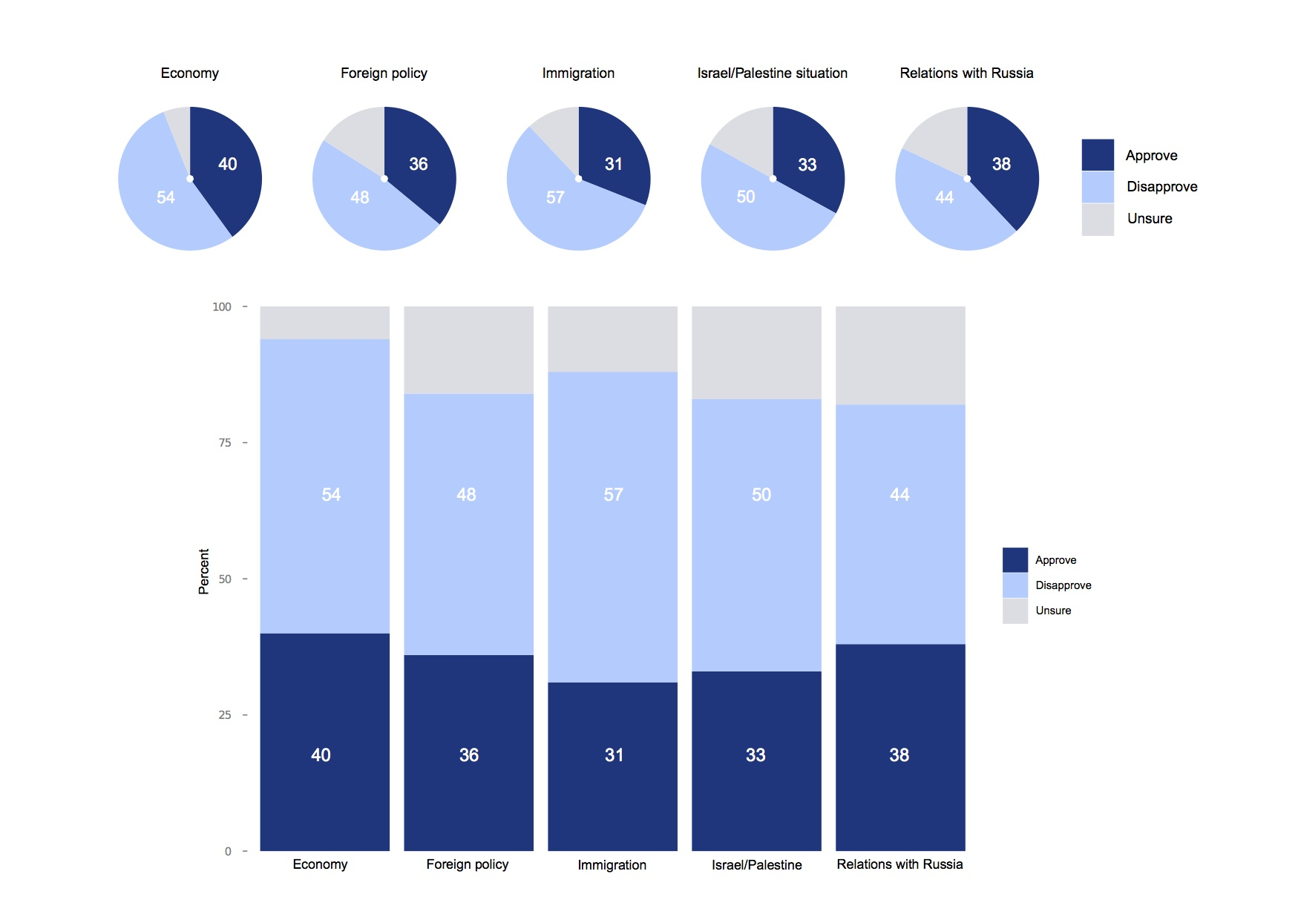
Composition: parts of the whole
Notes:
Which of these two representations of an August 2014 poll of public opinion on President Barack Obama’s job performance makes the differences between his approval ratings for difference policy areas easiest to read, the pie charts or the stacked column charts below?
These graphics involve both comparison and composition — a common situation in data journalism. Note also the use of color: a neutral gray is used for the “unsures,”” to de-emphasize this category and draw attention to the difference between the size of the “approve” and “disapprove” values.
Now consider the choices made in ordering the sections of each column. Do you think these charts were designed to make approval ratings easier to compare, or disapproval? How does this relate to the perceptual heirarchy of visual cues?
I would suggest abandoning pie charts if there are any more than three parts to the whole, as they become very hard to read when there are many segments. ProPublica’s graphics style guide goes further, allowing pie charts with two segments only.
21

Slide 22
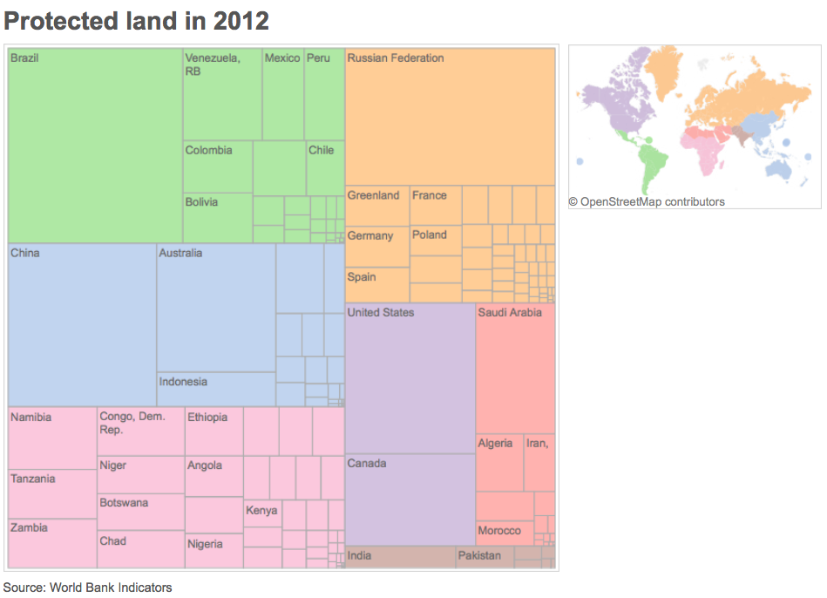
Composition: parts of the whole
Notes:
Another approach, known as a treemap, uses area to encode the size of parts of the whole. Although area falls lower on the perceptual hierarchy of visual cues than position/length, it can be effective to display “nested” variables — where each part of the whole is broken down into further parts.
22

Slide 23
Notes:
Composition: change over time
Data journalists frequently need to show how parts of the whole vary over time.
23

Slide 24
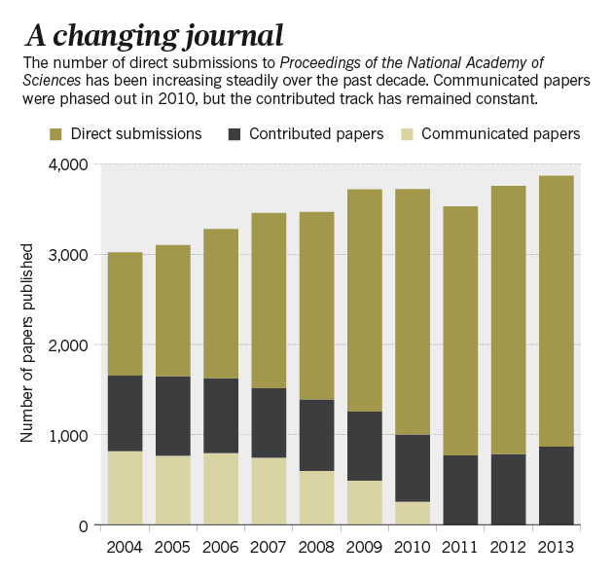
Composition: change over time
Notes:
Stacked column charts can also be used to simultaneously show change in composition over time and change in the size of the whole. This example is from one of my own articles, looking at change over time in the numbers of three categories of scientific research papers in published in the journal Proceedings of the National Academy of Sciences:
24

Slide 25
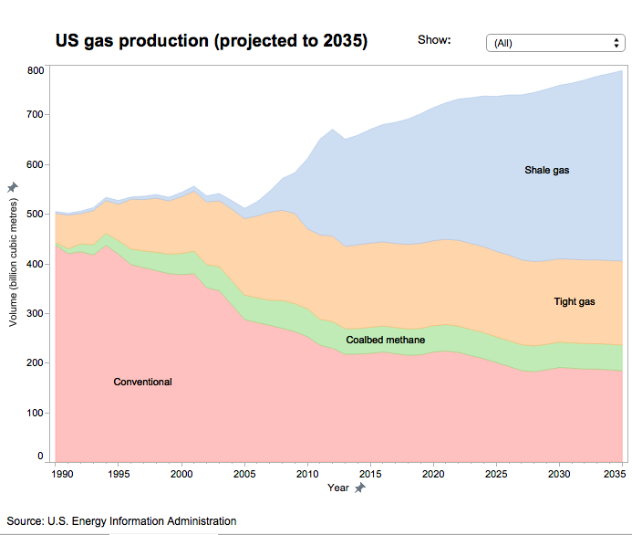
Composition: change over time
Notes:
Just as for simple comparisons over time, columns are not the only possibility when plotting changes in composition over time. The equivalent of the line chart, stressing the overall trend rather than values at discrete points in time, is the stacked area chart.
25

Slide 26
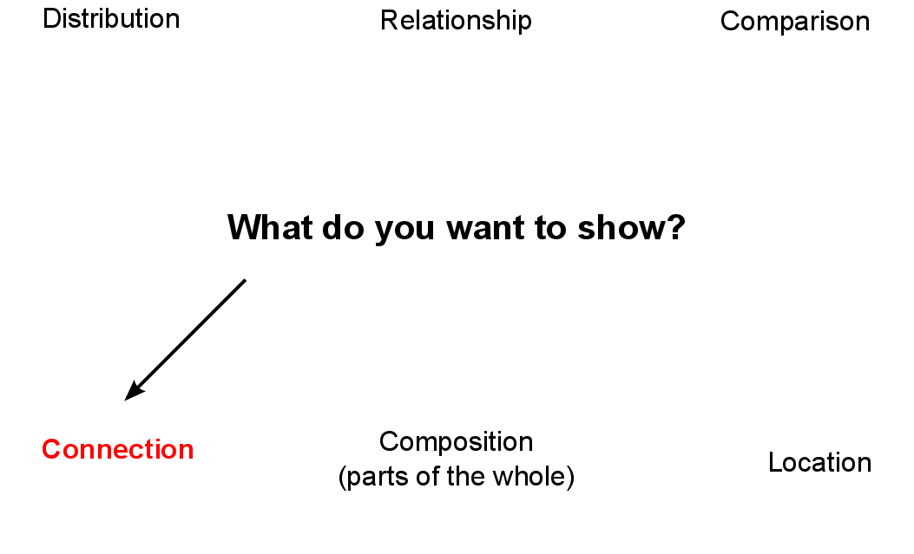
Notes:
This is a frequently asked question, and the best answer is: Experiment with different charts, to see which works best to liberate the story in your data.

Slide 27
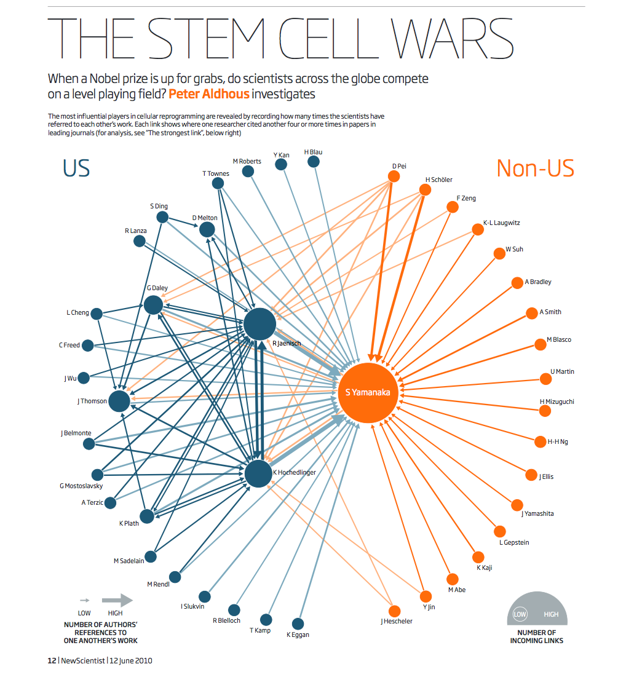
Connection:
network graphs
New Scientist

Slide 28
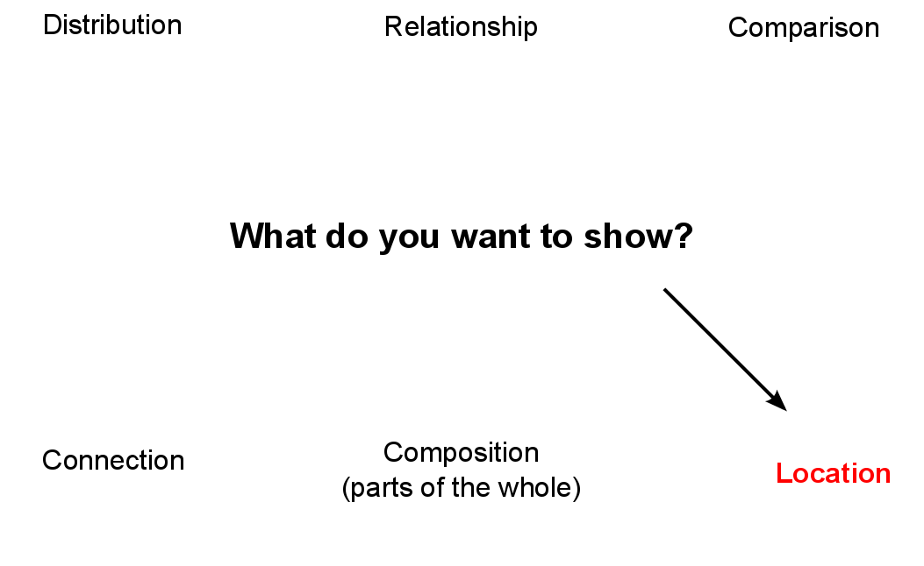
Notes:
This is a frequently asked question, and the best answer is: Experiment with different charts, to see which works best to liberate the story in your data.

Slide 29
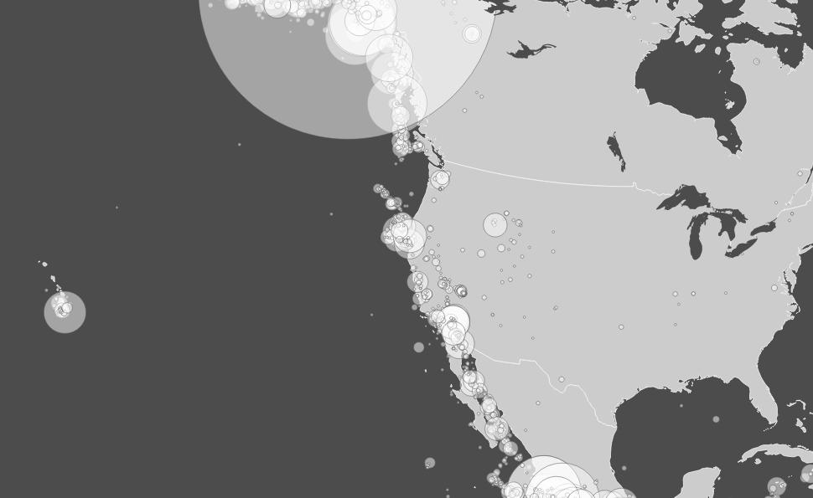
Location plus data: scaled circles
Notes:
Many of you are mapping specialists, and so will be well aware of the two main ways in which data can be represented on maps. When continuous variables are plotted to points, one common approach is to use circles centered on each point, sized according to the data values. [Here](http://www.nytimes.com/interactive/2011/04/28/us/tornado-deaths.html) is a example of this approach from *The New York Times*, used to show fatalities caused by tornadoes.

Slide 30
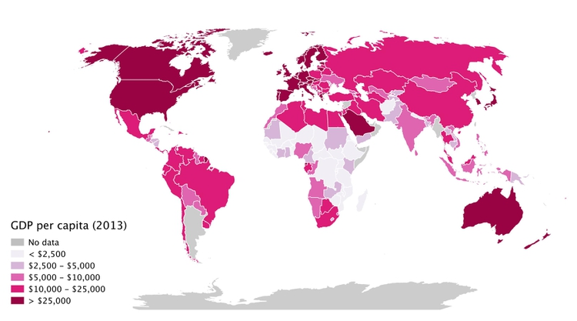
Location plus data: choropleth maps
Notes:
When plotting data to geographical areas, the most common approach is to fill the areas with color, with its intensity encoded according to the data values, like my maps of GDP per capita. These are known as choropleth maps.

Slide 31
Remember the perceptual hierarchy of
visual cues!
Notes:
Now look again at the perceptual hierarchy of visual cues, and note that area and color intensity — the main options available when putting data onto maps — sit fairly low on the hierarchy.
31

Slide 32
So ask yourself: Is a map the best way to
tell the story?
Notes:
Consider these two representations of similar data on rates of overall gun death (the map) and gun homicides (the bar chart) by U.S. state.
The bar chart clearly allows the more detailed comparison between rates for different states. However, the map still has value because it does show that the states with the highest gun death rates occur in particular geographic locations. In cases like this, consider using a map as only one part of your graphic, perhaps as a secondary element.

Slide 33
Case study: Immunization in
California kindergartens

Slide 34
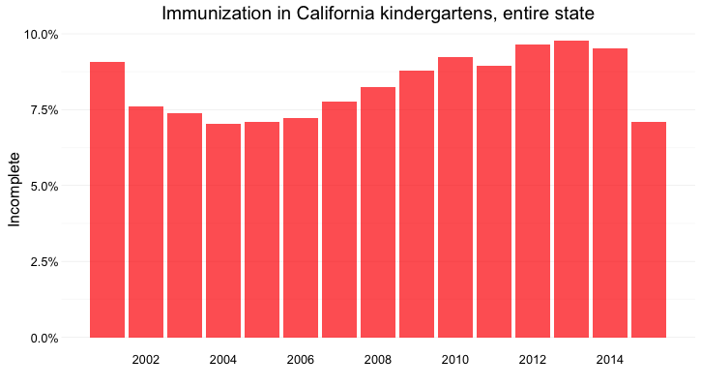
Length on aligned scale

Slide 35
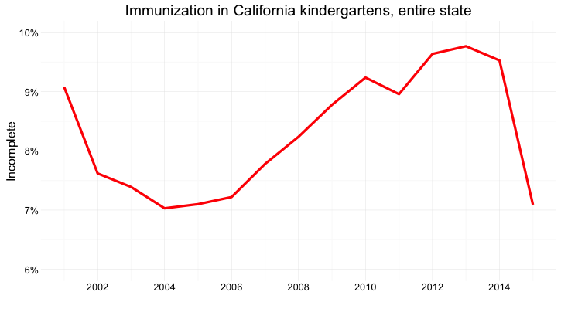
Slope, note the y axis scale

Slide 36
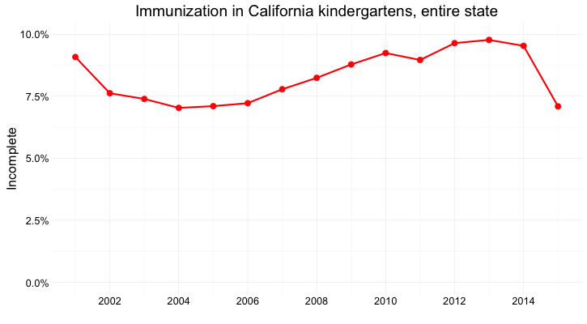
Position on aligned scale + slope

Slide 37
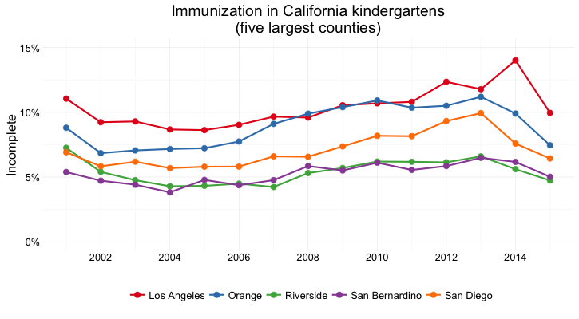
Several counties
Notes:
Position on an aligned scale and slope

Slide 38
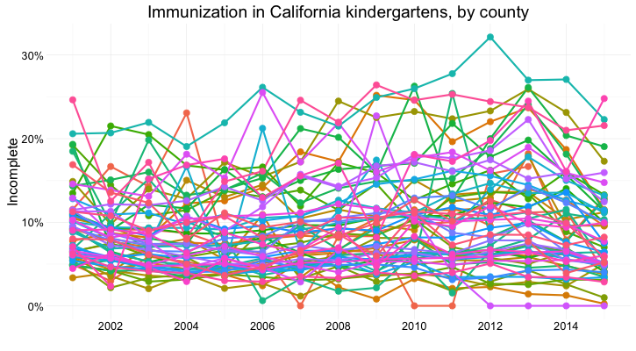
All the counties: Too many lines, too few colors
Notes:
Too many lines, too few colors!

Slide 39
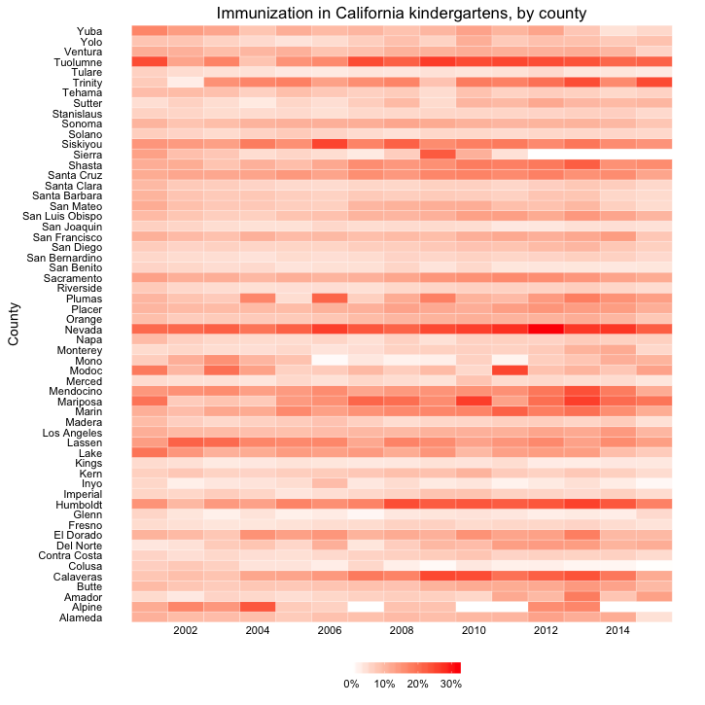
A solution:
color intensity

Slide 40
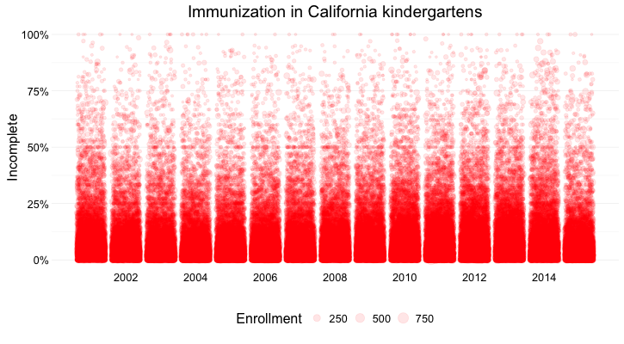
All the schools: Position on aligned scale + area
Notes:
You can also combine different visual cues into the same graphic to encode different variables. But always think about the main messages you are trying to impart, and where you can use visual cues near the top of the visual hierarchy to communicate that message most effectively. The main message here is about the distribution of incomplete rates across schools. The enrollment of each school is secondary, but can be added using area.

Slide 41
Using color effectively
Notes:
Color falls low on the perceptual hierarchy of visual cues, but as we have already seen, it is often deployed to highlight particular elements of a chart, and sometimes to encode data values. Poor choice of color schemes is a problem that bedevils many news graphics, so it is worth taking some time to consider how to use color to maximum effect.

Slide 42

The color wheel
Notes:
It helps to think about colors in terms of the color wheel, which places colors that “harmonize” well together side by side, and arranges those that have strong visual contrast — blue and orange, for instance — at opposite sides of the circle:

Slide 43
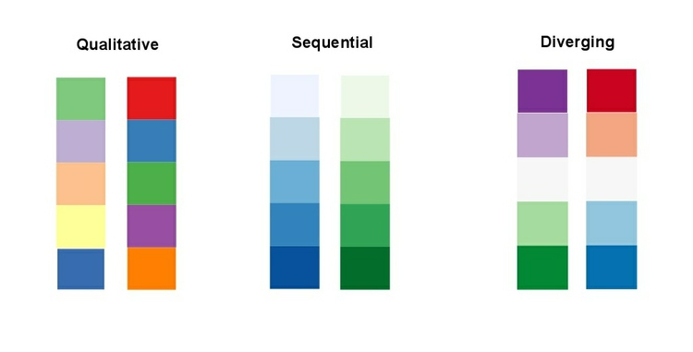
Using color: fit to your data
Notes:
When encoding data with color, take care to fit the color scheme to your data, and the story you’re aiming to tell. As we have already seen, color is often used to encode the values of categorical data. Here you want to use “qualitative” color schemes, where the aim is to pick colors that will be maximally distinctive, as widely spread around the color wheel as possible:
43

Slide 44
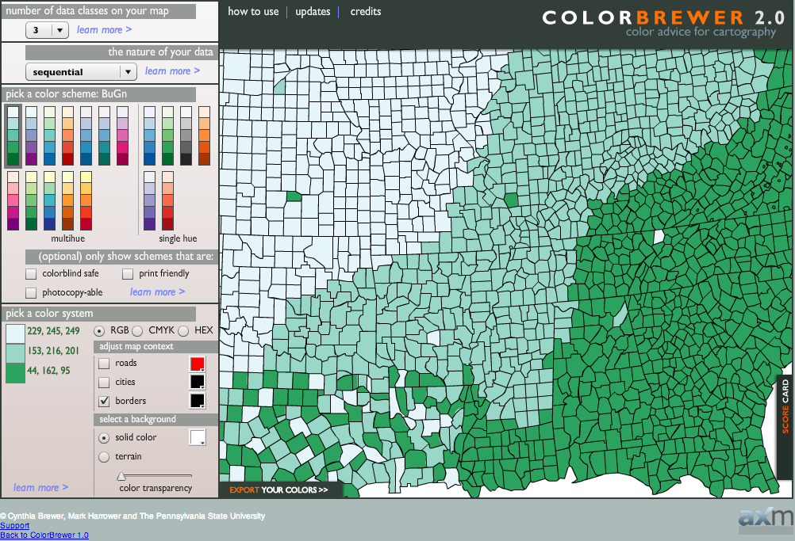
ColorBrewer is your friend
Notes:
Choosing color schemes is a complex science and art, but there is no need to “roll your own” for every graphic you make. Many visualization tools include suggested color palettes, and I often make use of the website from which the examples above were taken, called ColorBrewer. Orginally designed for maps, but useful for charts in general, these color schemes have been rigorously tested to be maximally informative.
44

Slide 45
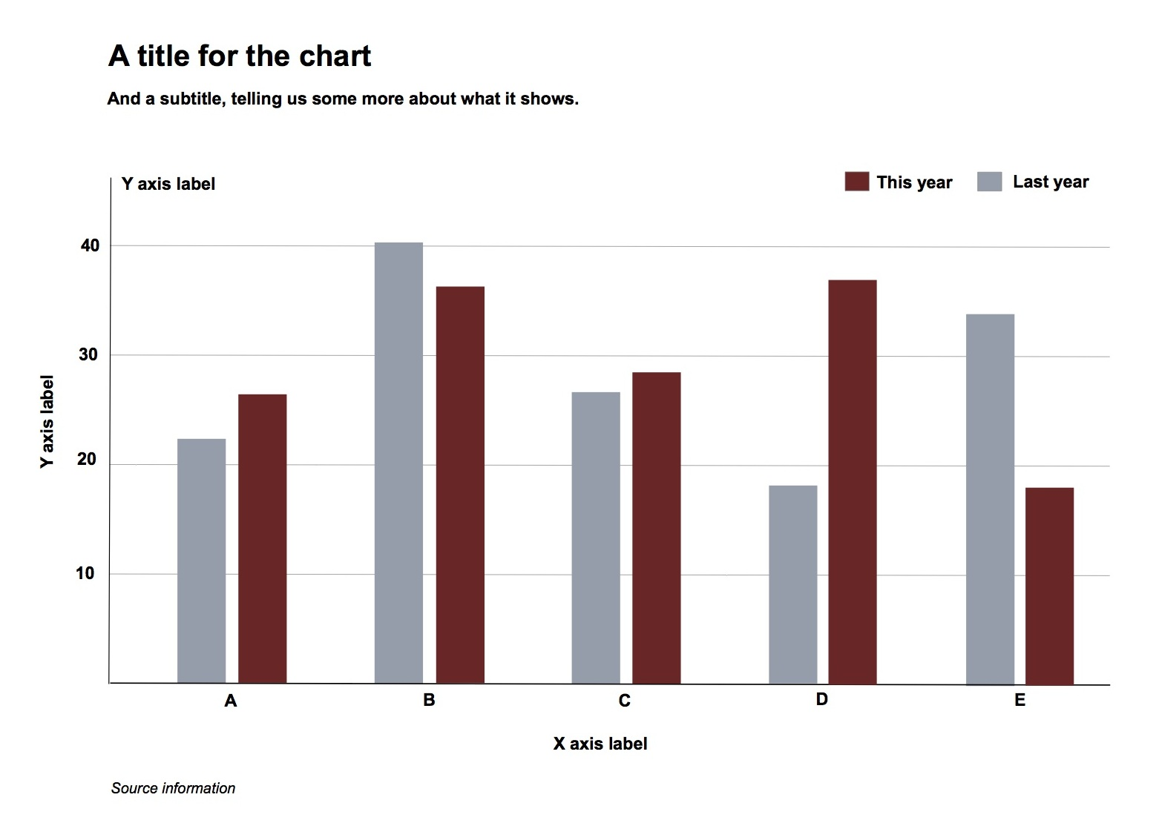
Chart furniture
Notes:
Here are those elements displayed on a sample chart. Note that I’ve included two possible positions for a Y axis label. The version at the top of the chart can be a good option, as it doesn’t require people to tilt their heads to read vertical text.
45

Slide 46
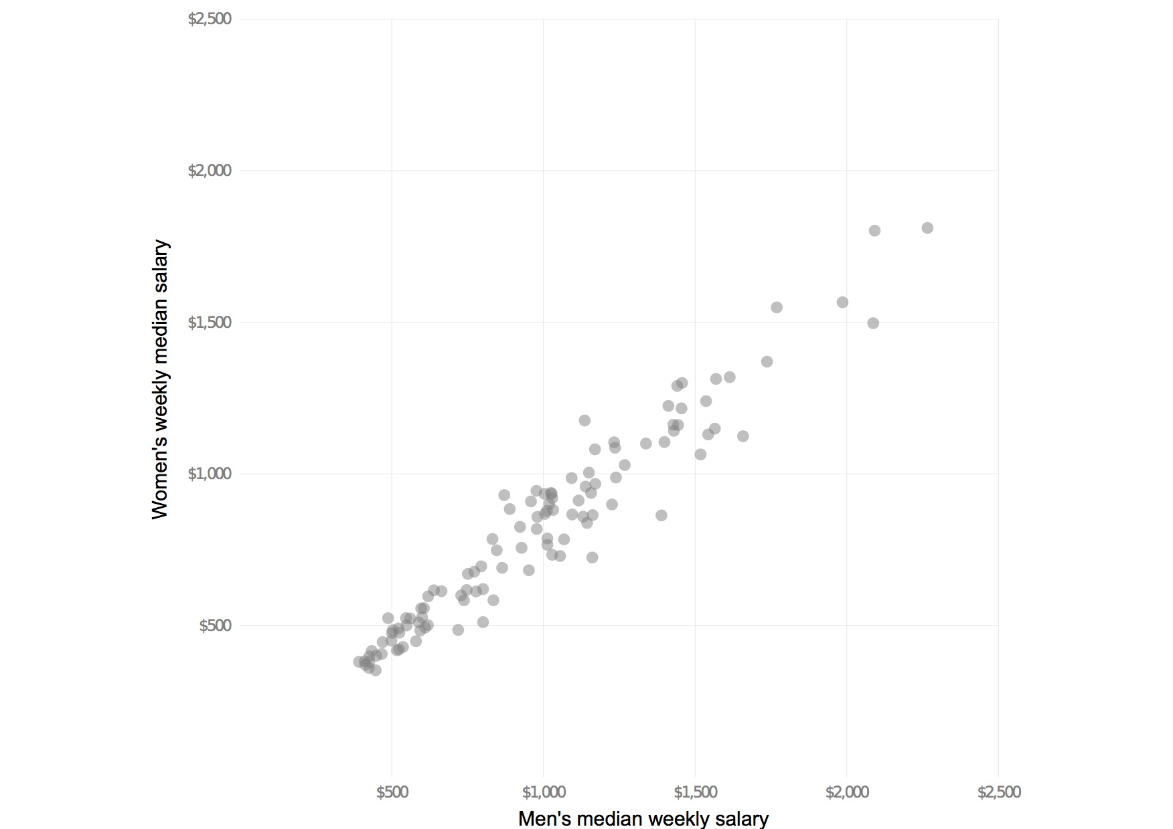
Highlight the story: labels and annotation
Notes:
Simple annotations and spot-color highlights can be particularly useful to highlight your story, as shown in the following scatter plots, used here to show the relationship between the median salaries paid to women and men for the same jobs in 2013. In this case there is no suggestion of causation; it is also clear from the first, unlabeled plot, that male and female salaries for the same job are strongly correlated, but that relationship is not very interesting. Notice also how I have used transparency to help distinguish overlapping individual points.
46

Slide 47
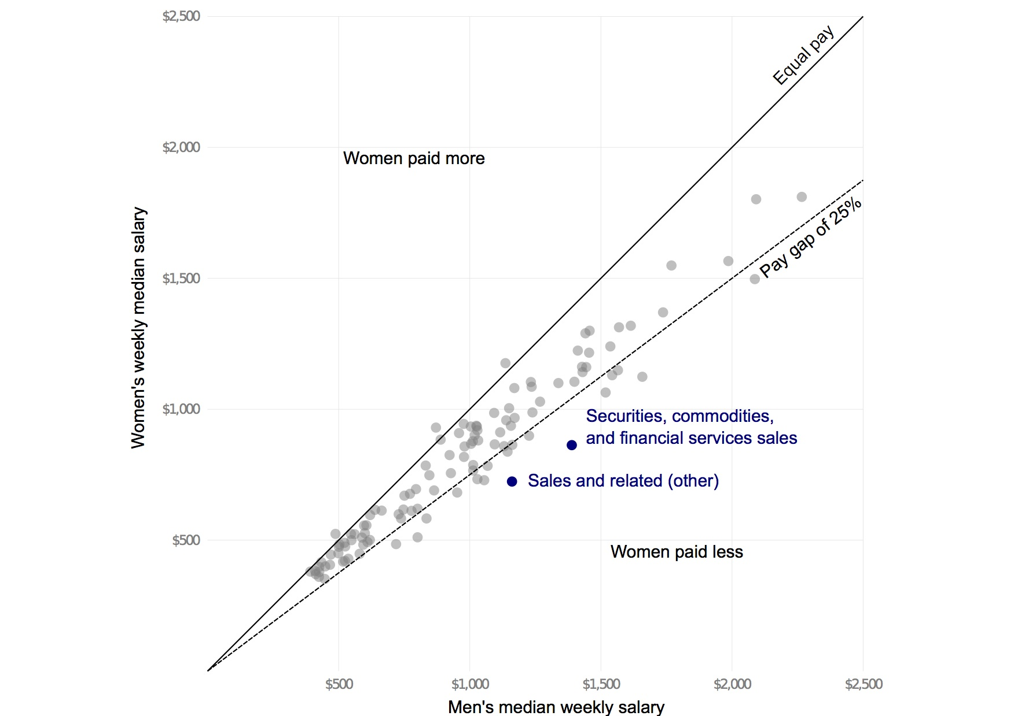
Highlight the story: labels and annotation
Notes:
Notice how adding another line, representing a 25% pay gap, and highlighting the jobs where the pay gap between men and women is largest, emphasizes different aspects of the story:
47

Slide 48
When in doubt:
keep it clean, clear and simple!
(But aim for clarity over simplicity)
Notes:
Above all, aim for clarity and simplicity in your chart design. Clarity should trump simplicity. As Albert Einstein is reputed to have said: “Everything should be made as simple as possible, but not simpler.”
48

Slide 49
Experiment! Sketch!
That may be how you find the story
Show people. If they’re confused, try another approach
Notes:
One messageI’d like you to take from this workshop is that there are many ways of visualizing the same data. Effective static graphics and interactives do not usually emerge fully formed. They usually arise through sketching and experimentation. Kevin Quealy’s chartsnthings blog provides a window into how this process works on the graphics desk of The New York Times.
As you sketch and experiment with data, use the framework suggested by the chart selector thought-starter to prioritize different chart types, and definitely keep the perceptual hierarchy of visual cues at the front of your mind. Remember the mantra: Design for the human brain!
Also, show your experiments to friends and colleagues. If people are confused or don’t see the story, you made need to try a different approach.
49

Slide 50
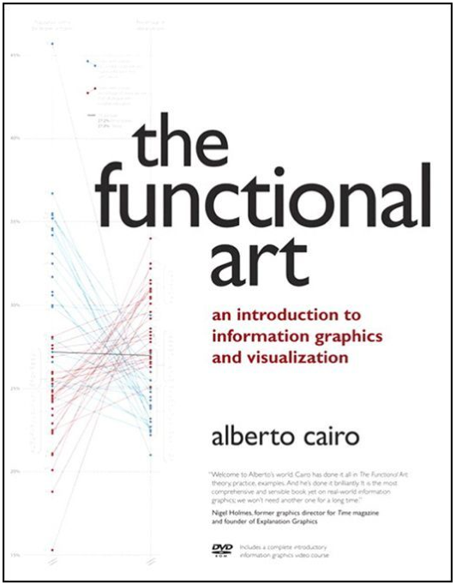
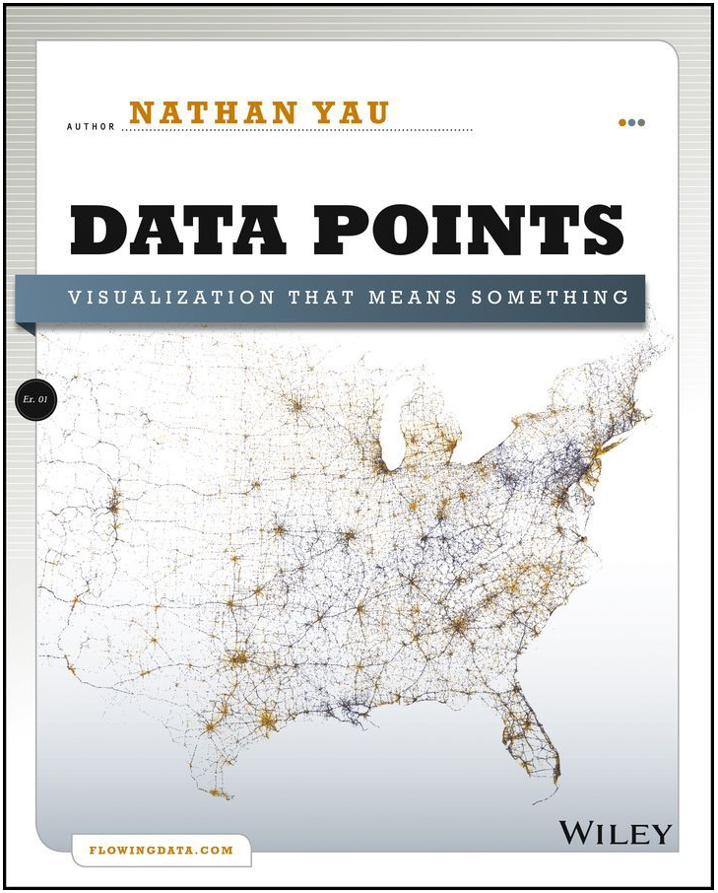
Recommended reading

